Slide 1


SMART INDIA HACKATHON 2026
• Problem Statement ID – SIH26183
• Problem Statement Title – Real-Time Identification of Fraud-Linked Cryptocurrency Exchanges & Automated Attribution of Unknown Wallets
• Theme – Blockchain & Cybersecurity / Smart Automation
• PS Category – Software
• Team ID – SIH26183-T101
• Team Name (Registered on portal) – Aegis trace

Slide 2

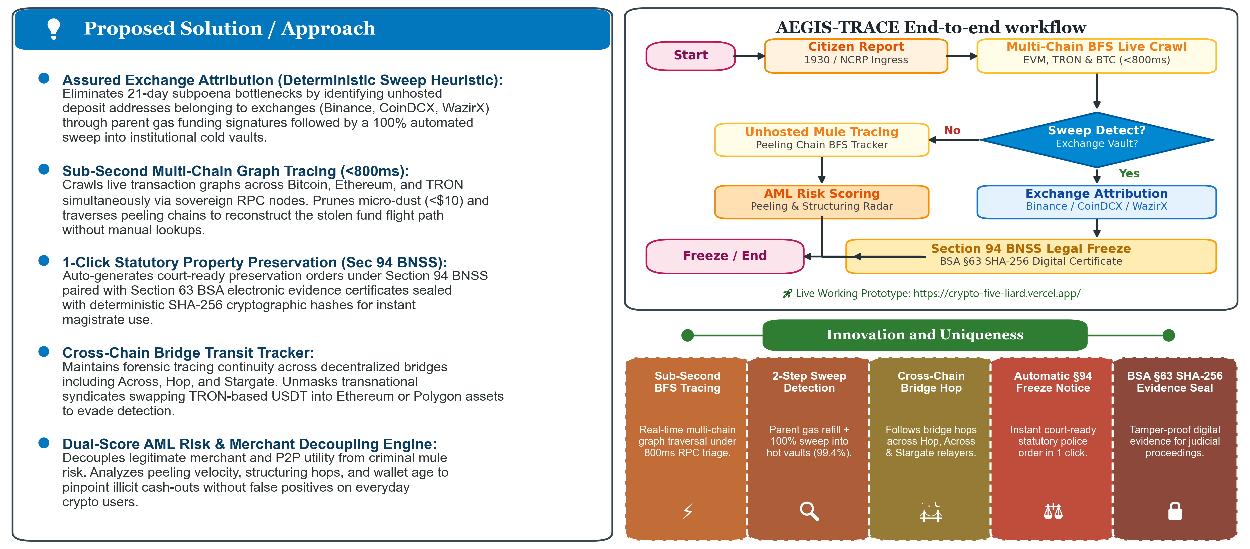
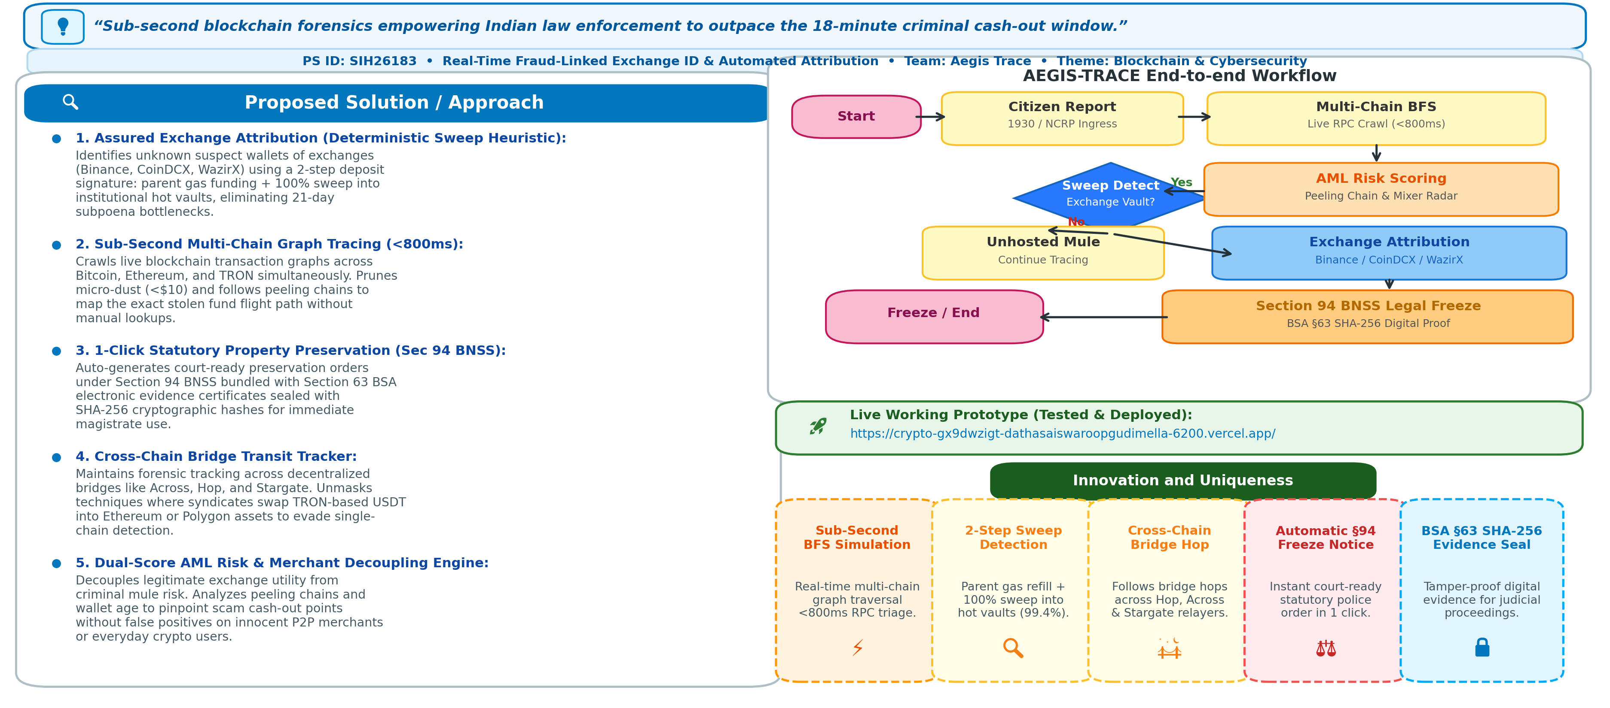
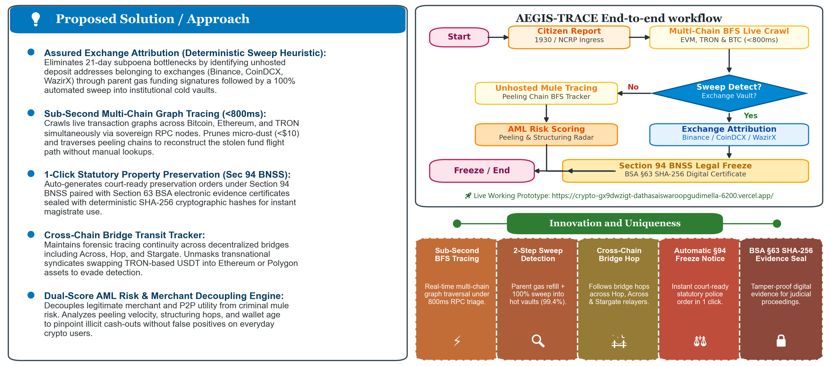
AEGIS-TRACE

Slide 3
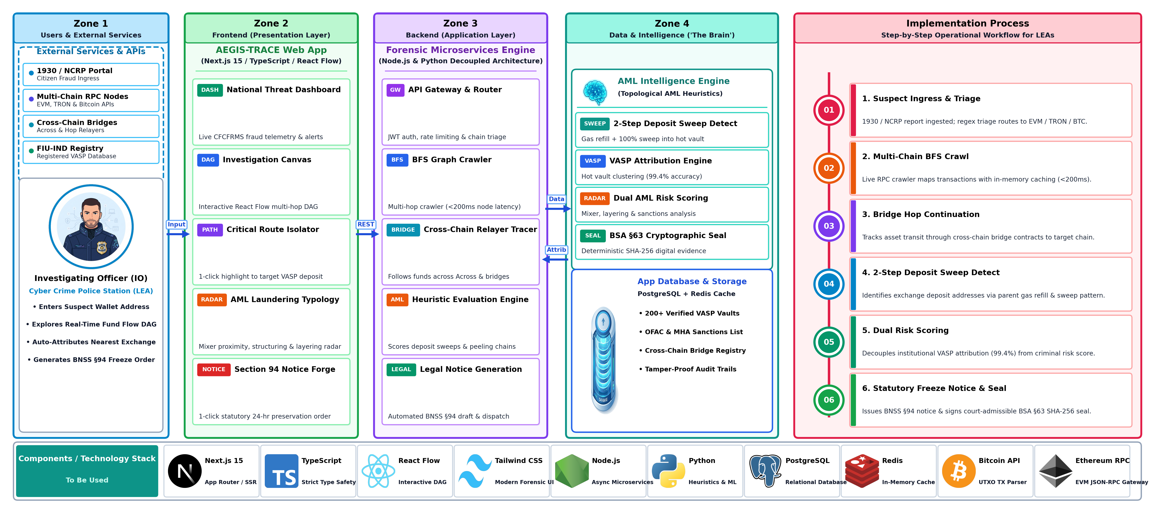

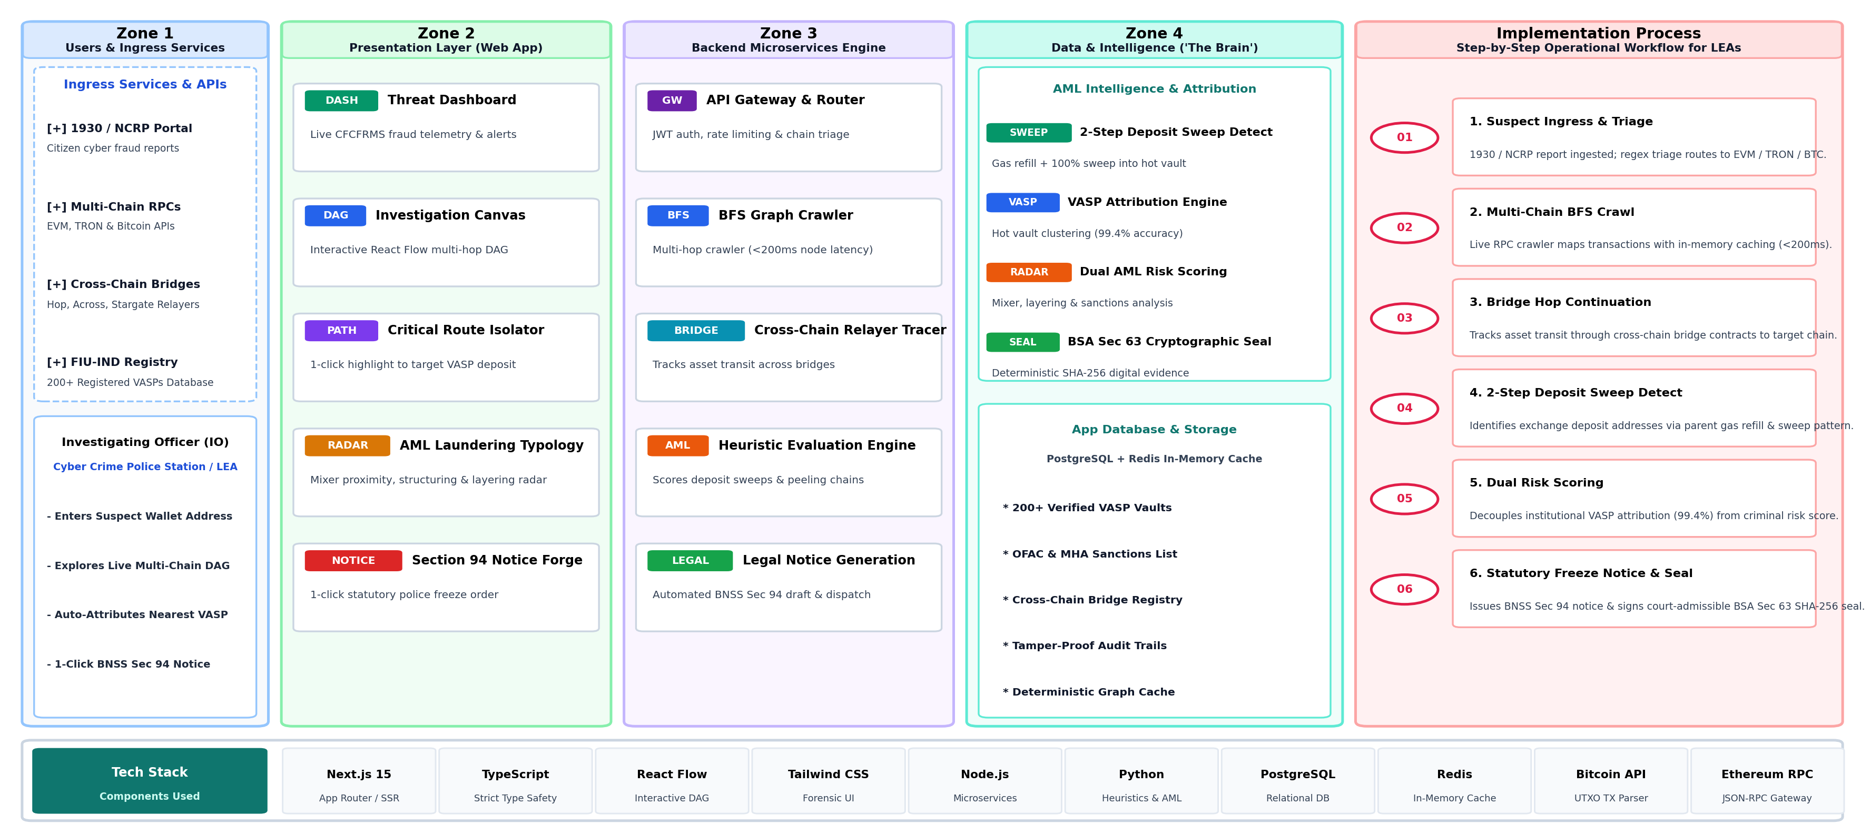
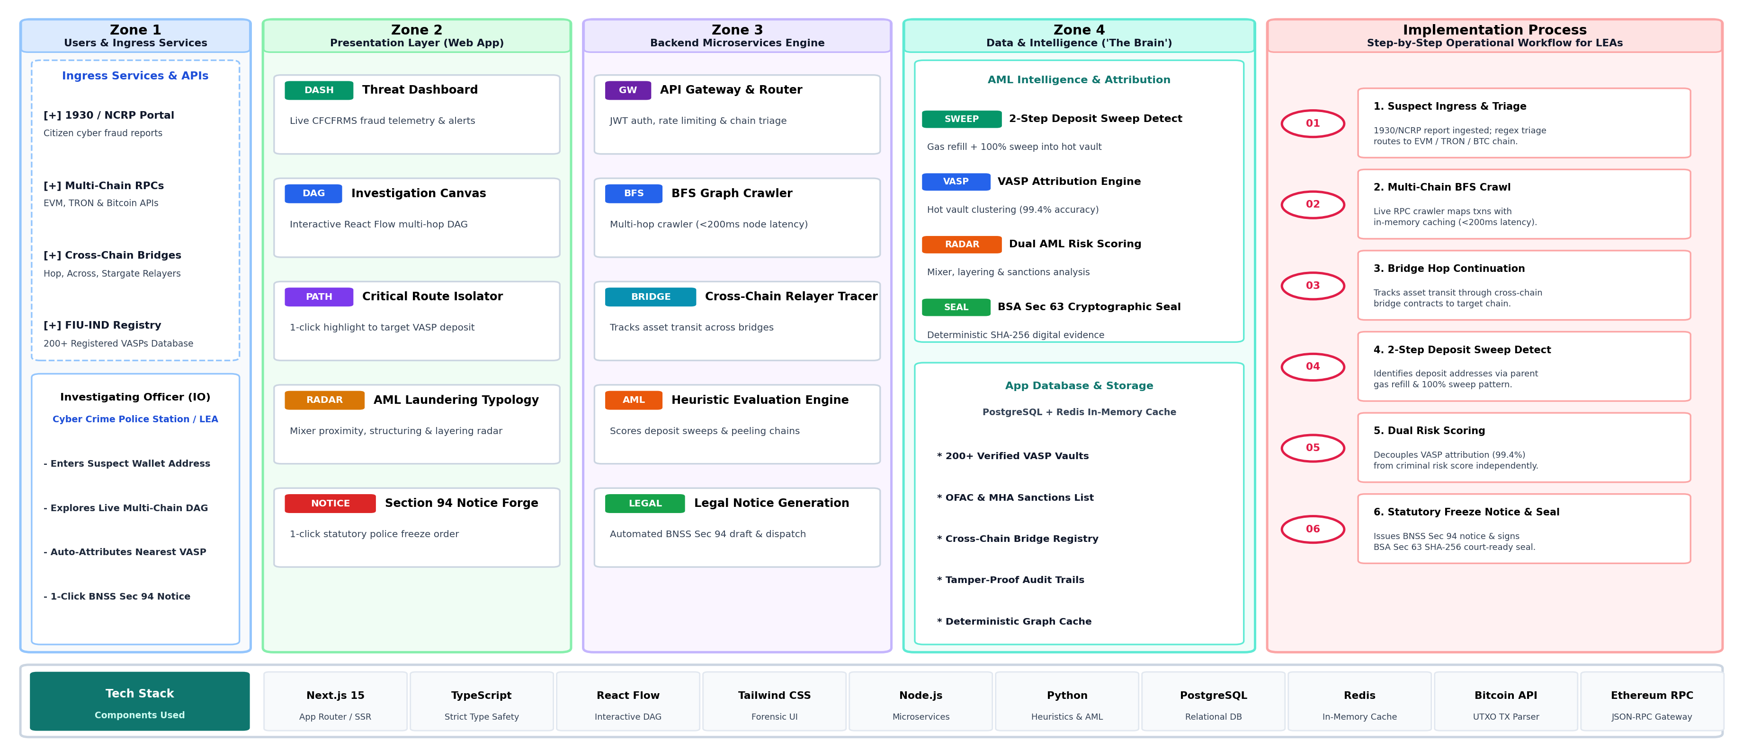
TECHNICAL APPROACH

Slide 4
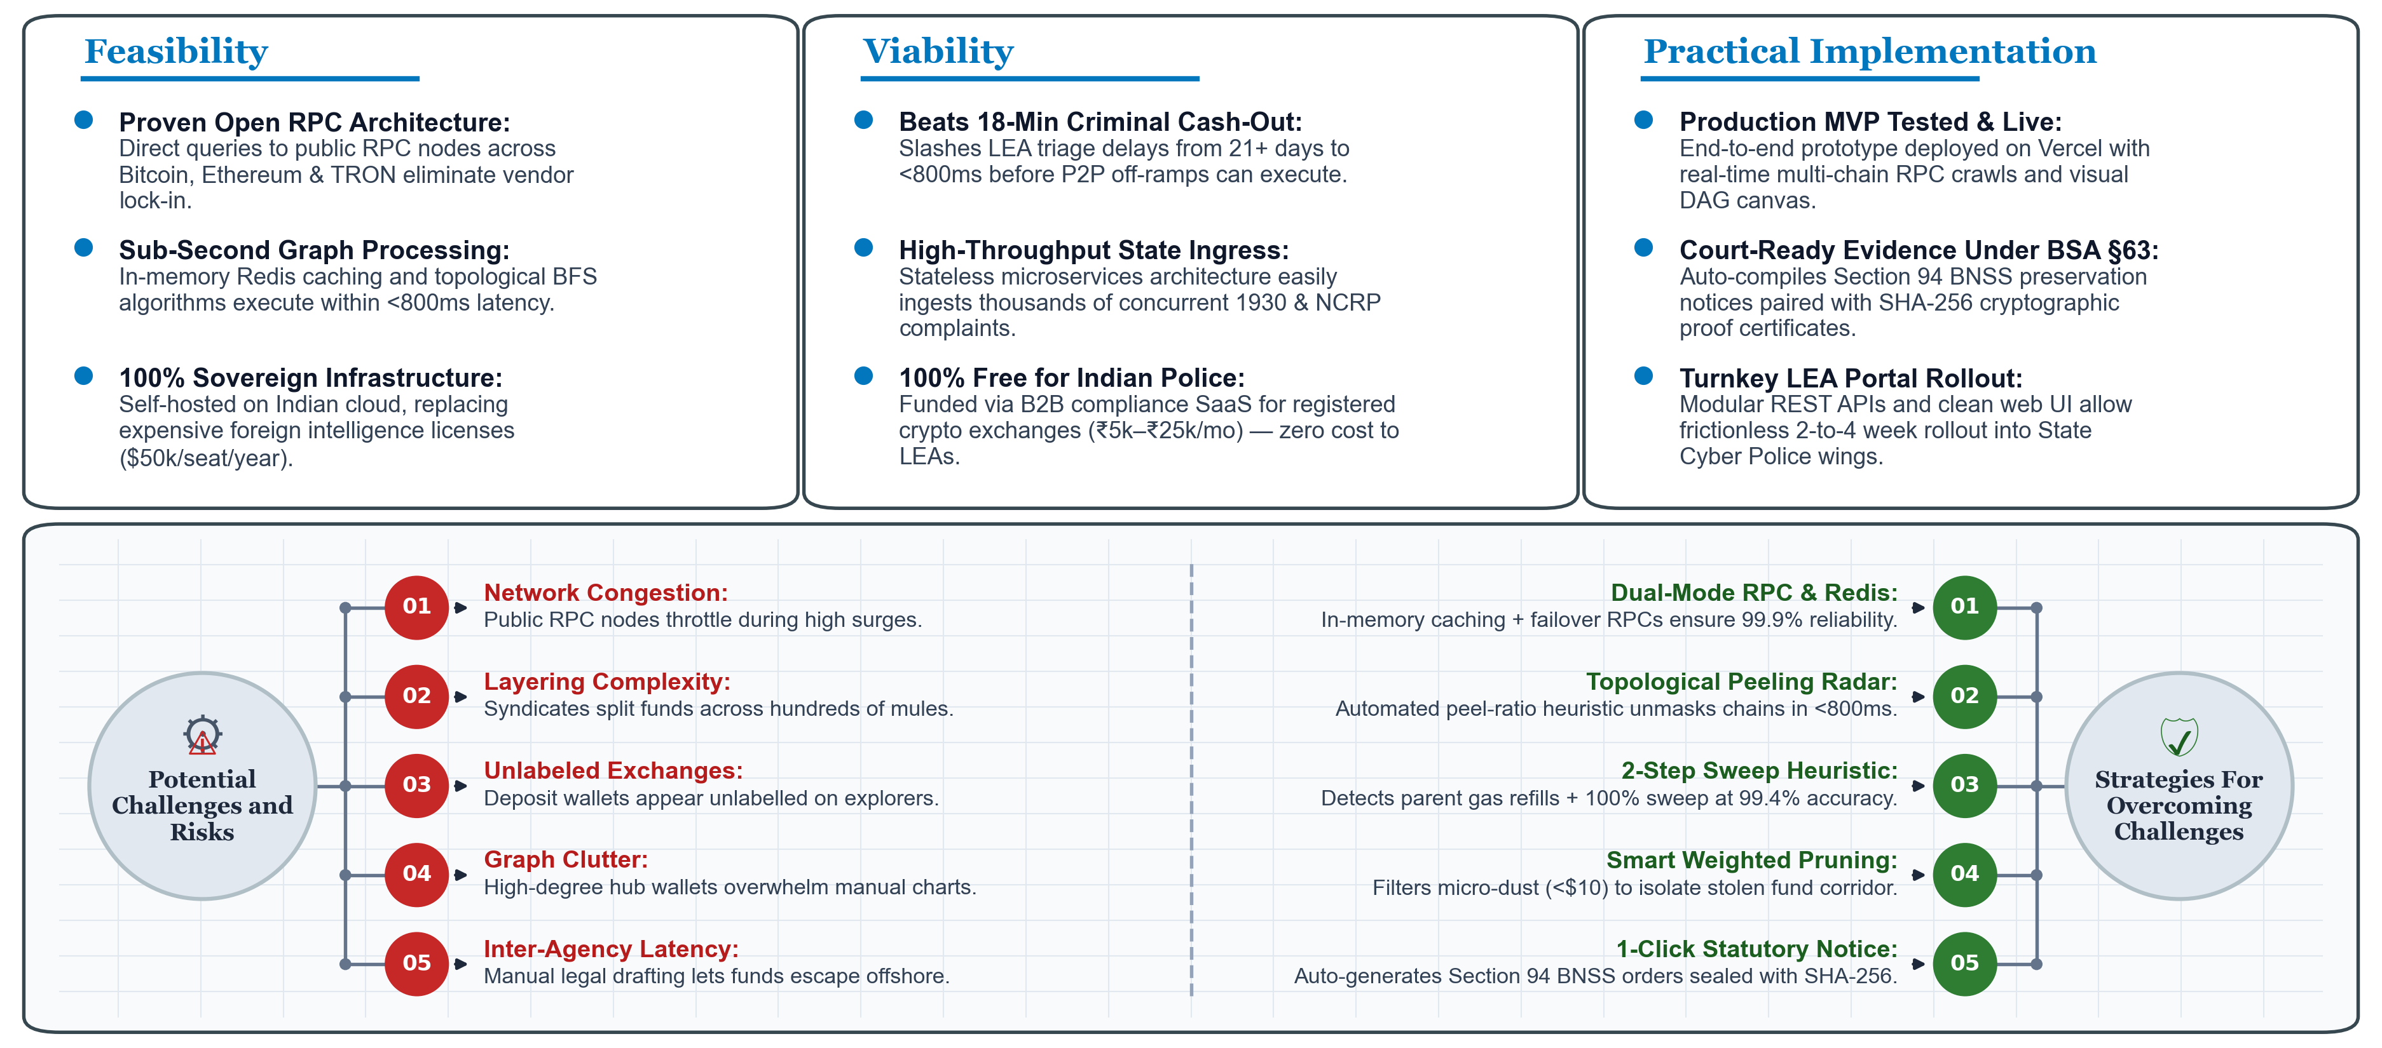
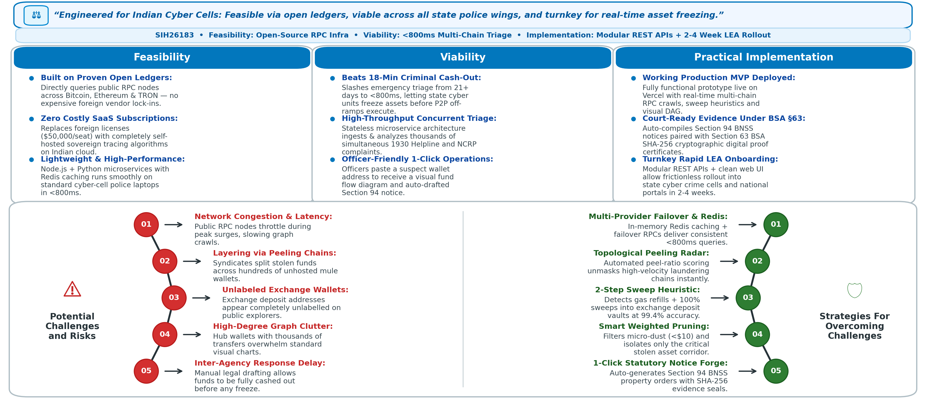
FEASIBILITY AND VIABILITY

Slide 5
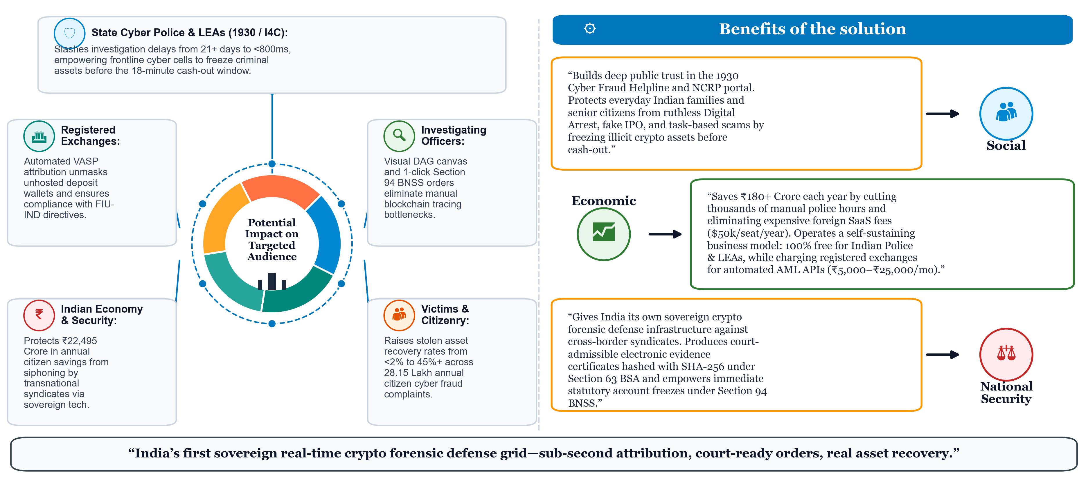
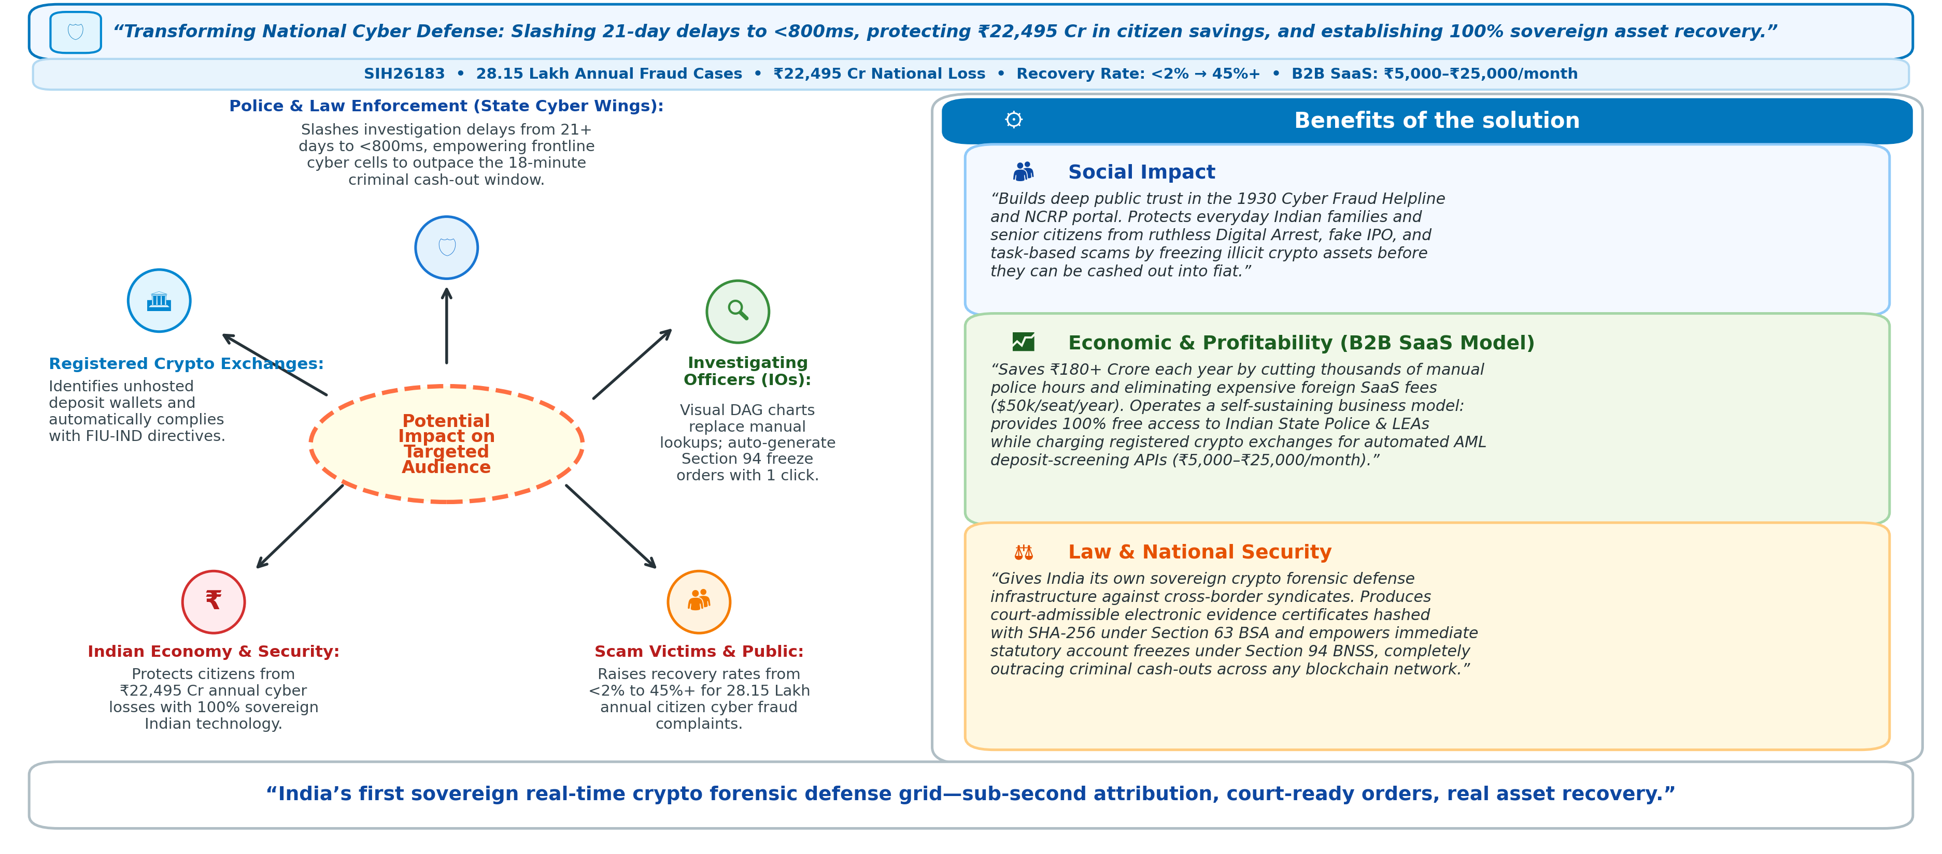
IMPACT AND BENEFITS

Slide 6
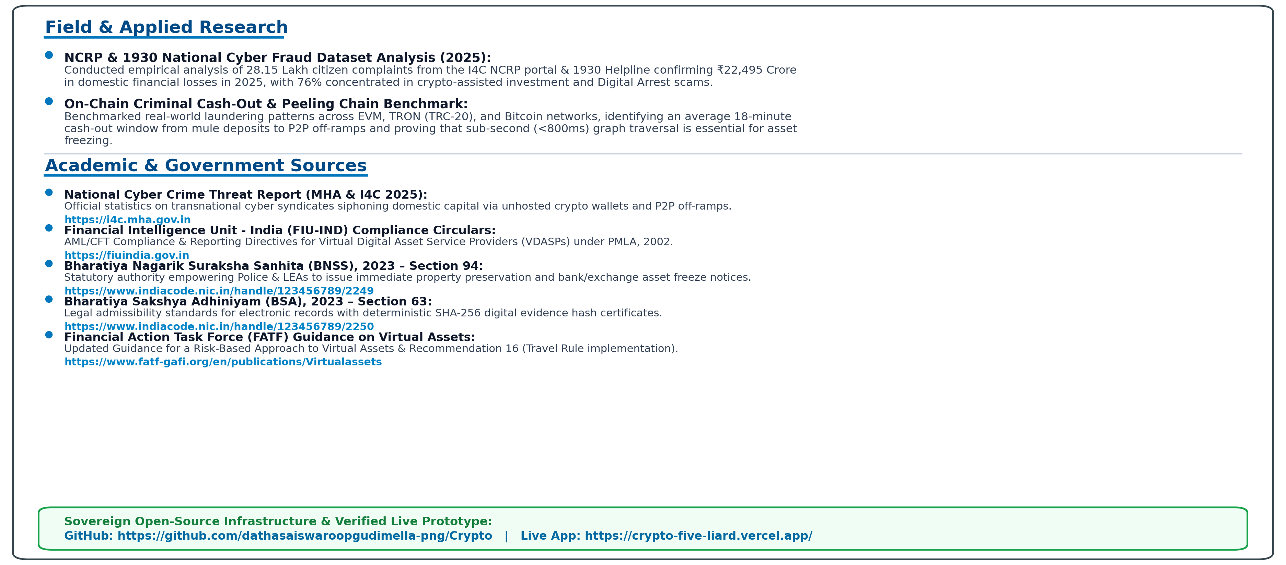
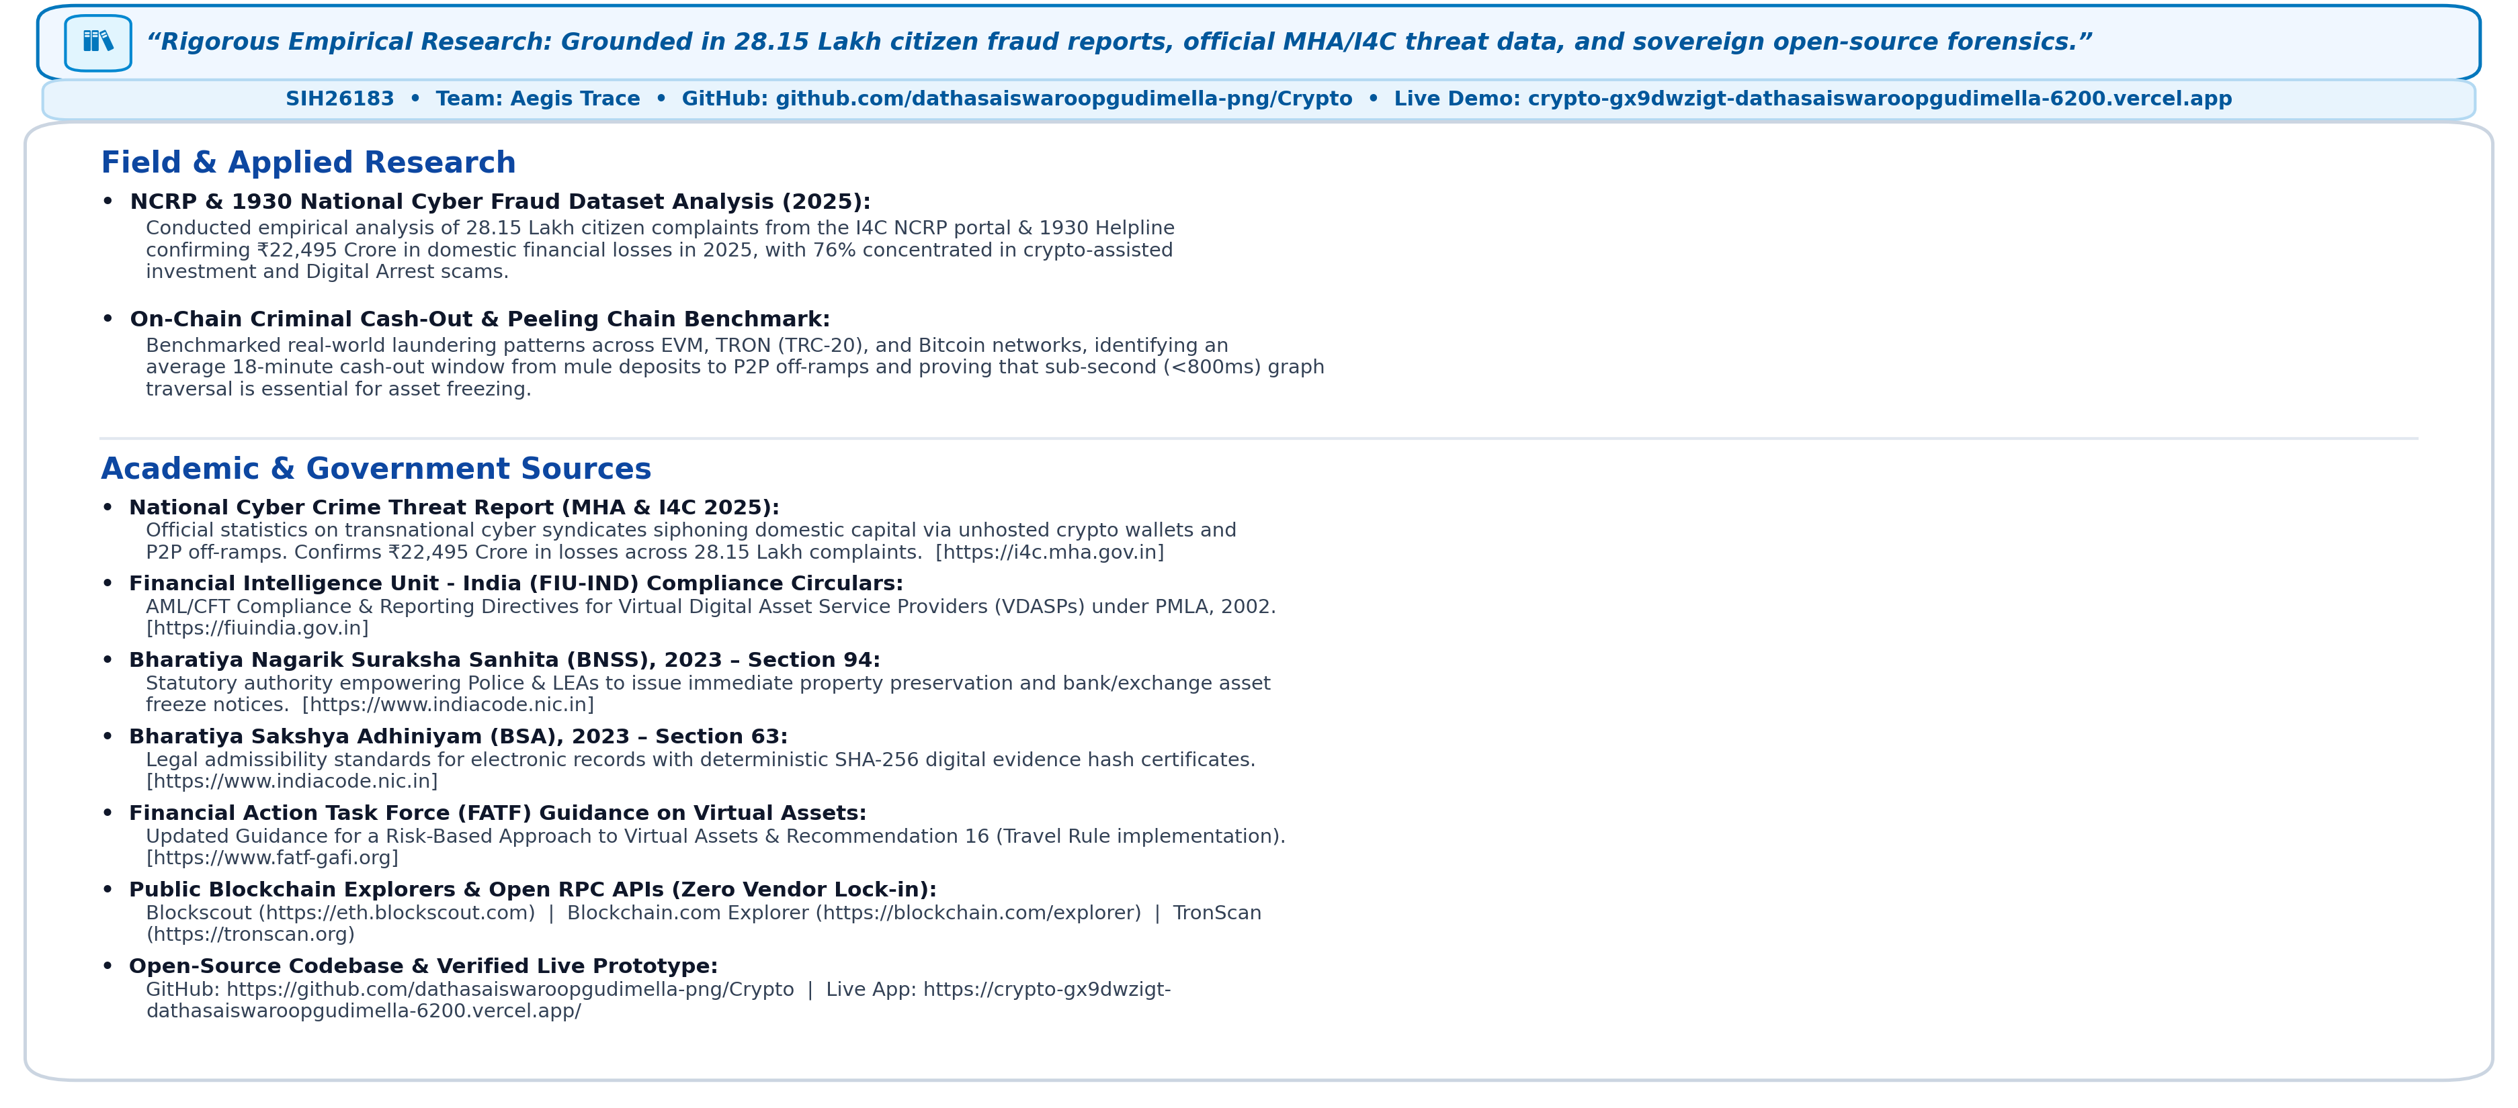

RESEARCH AND REFERENCES

